Slide 1

The Taylor swift discography
Luci Barnett and Ben Gierhart Team Project 1 DS160 – Introduction to Data Science Fall 2024

Slide 2

Who is taylor swift?
Just kidding
Ben

Slide 3

About the dataset
Taylor Swift Discography (TTPD included) dataset from Kaggle.
For context, TTPD stands for The Tortured Poets Department, Taylor Swift’s latest album.
Regularly updated dataset by Kaggle user Delfina Oliva. It was last updated on September 24.
Gathers data from Spotify, Youtube, and Wikipedia.
Luci

Slide 4
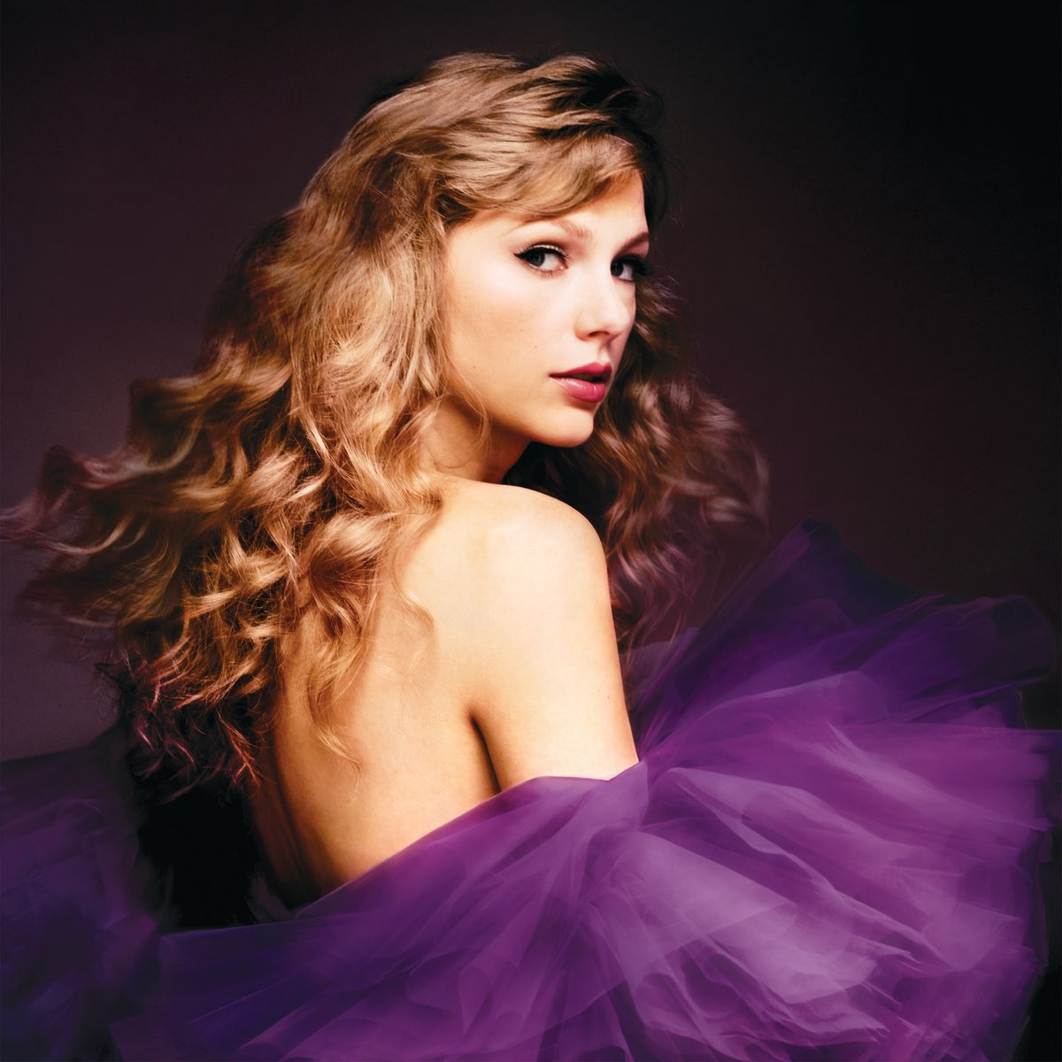
About the dataset (cont.)
28 columns total. Explanations for the ones that aren't self-explanatory:
ID - unique identifier for each track
duration_ms - the duration of the track in milliseconds
videoclip_views - the number of views of the track's videoclip on YouTube
spotify_streams - the number of streams (listens) the track has on Spotify
spotify_global_peak - the highest global ranking the track achieved on Spotify charts
track_number - the order the song appears on it's album
album_physical_sales - the physical sales of the album
acousticness - a measure of how acoustic the track is (0 to 1)
Ben

Slide 5

About the dataset (cont.)
danceability - a measure of how suitable the track is for dancing (0 to 1) based on a combination of musical elements including rhythm stability, tempo and beat
energy - the intensity and activity level of the track (0 to 1). Typically, energetic tracks feel fast, loud, and noisy
instrumentalness - a measure of how much of the track is instrumental (0 to 1). The closer the instrumentalness value is to 1.0, the greater likelihood the track contains no vocal content
liveness - a measure of how "live" the track feels, indicating audience presence (0 to 1). Tracks with higher liveness values are more likely to have been performed in a live setting
loudness - the overall loudness of the track in decibels (dB). Loudness is the quality of a sound that is the primary psychological correlate of physical strength (amplitude). Values typically range between -60 and 0 db
speechiness - a measure of the amount of spoken words in the track (0 to 1). The more exclusively speech-like the recording (e.g. talk show, audio book, poetry), the closer to 1.0 the attribute value
tempo - the tempo or speed of the track in beats per minute (BPM). Tempo is the speed or pace of a given piece and derives directly from the average beat duration
valence - a measure of how positive or negative the track sounds (0 to 1). Tracks with high valence sound more positive
Luci

Slide 6
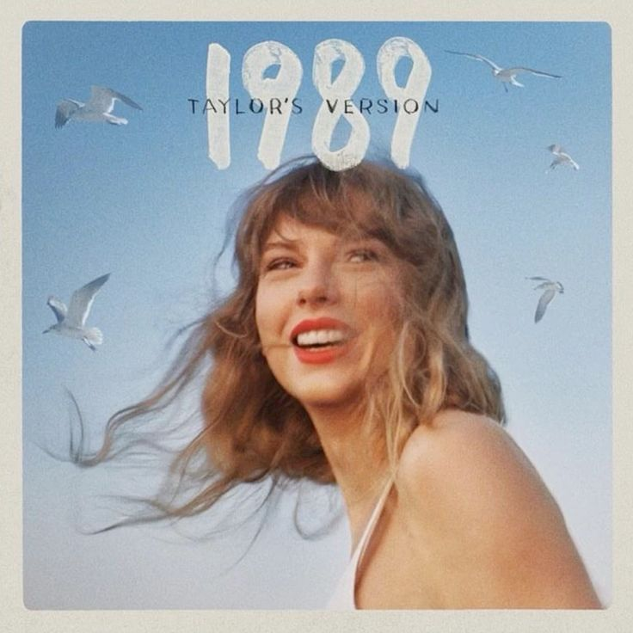
Rationale and Methodology
Our rationale is that Taylor Swift is currently the biggest pop star in the world, and so we wanted to look at this comprehensive dataset to learn more about the discography and career of this once-in-a-generation artist.
We explored multiple individual variables using data summary functions and visually with histograms and a pie chart.
We also used scatterplots, box plots, line graphs, bar charts, and a heat map while visually exploring the relationships between different variables.
Ben

Slide 7
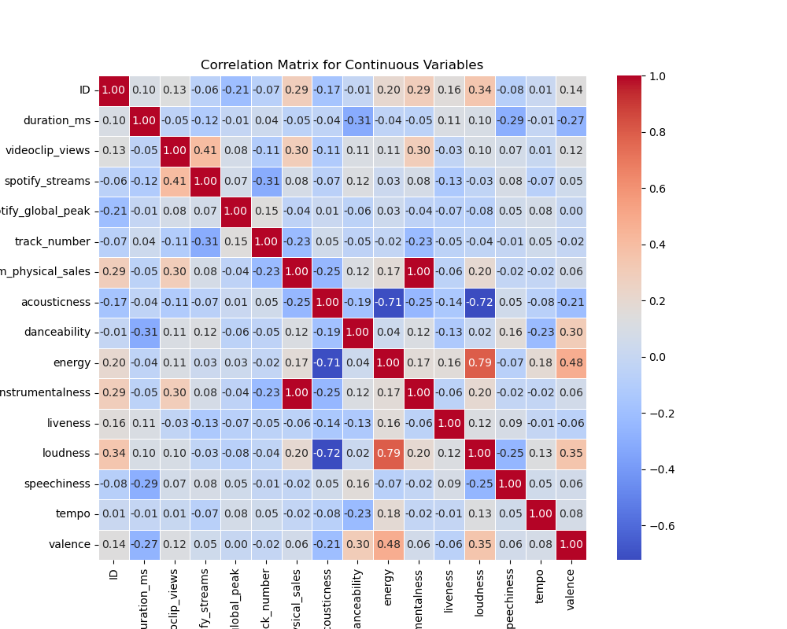
Correlation Heatmap
*acousticness and energy
*valence and energy
*Danceability AND Spotify streams
*ENERGY AND ALBUM SALES
Luci
Notes:
Strong negative linear relationship between acousticness and energy, indicating that more acoustic tracks tend to have lower energy levels
Moderate positive correlation (0.48) between valence and energy, meaning that songs with higher valence, which are generally perceived as happier, tend to have more energetic compositions.

Slide 8

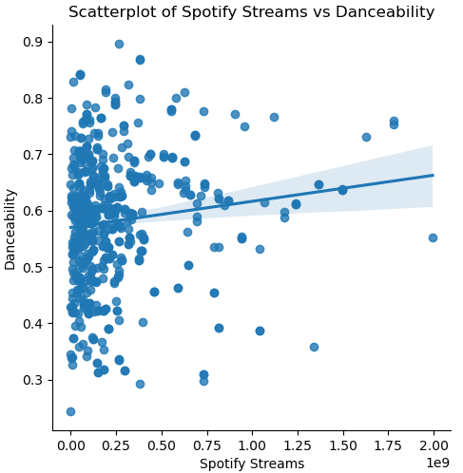
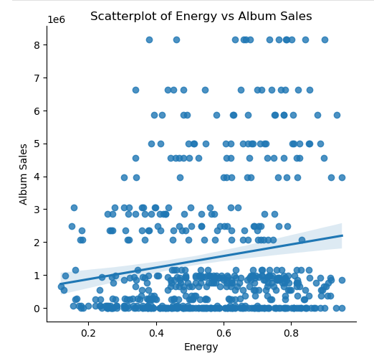
Quantitative Conclusions
Luci
Notes:
Danceability is positively correlated with Spotify streams, implying that more danceable tracks are generally more popular. Energy levels showed a slight positive correlation with album physical sales, suggesting that energetic tracks may contribute to better sales performance.
These findings suggest that both musical attributes and perceived emotion play a role in shaping a track’s popularity and commercial impact within Taylor Swift’s body of work.

Slide 9

Qualitative Observations
Notes:
With our chart, we can see that “Country Pop” album genre makes up 26.39% of the discography

Slide 10
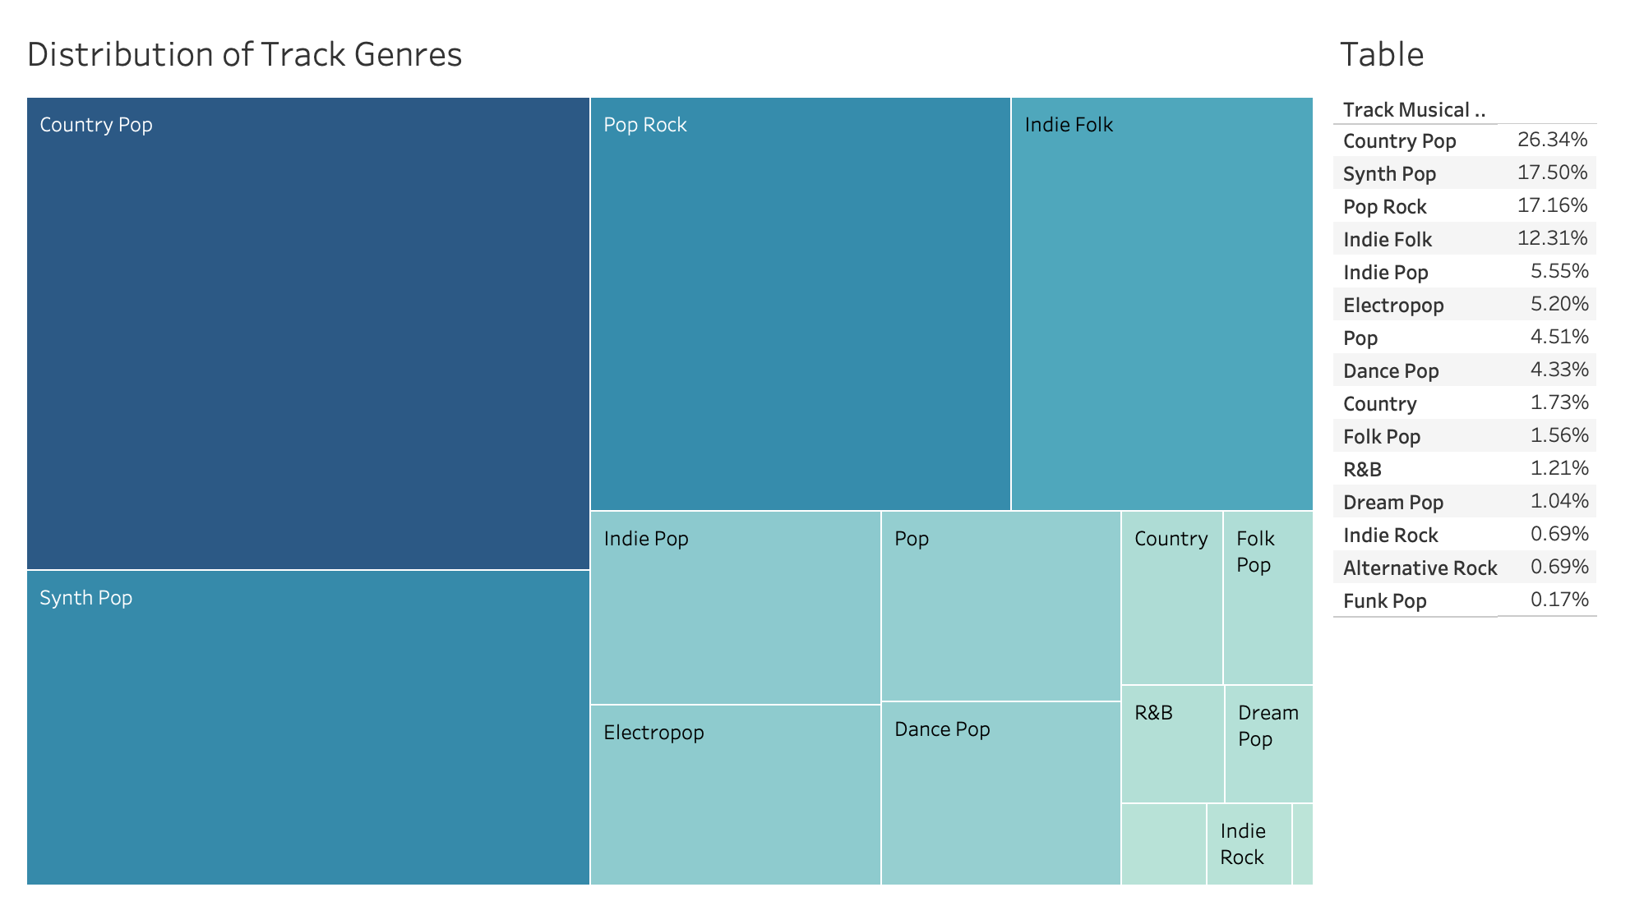
Ben

Slide 11
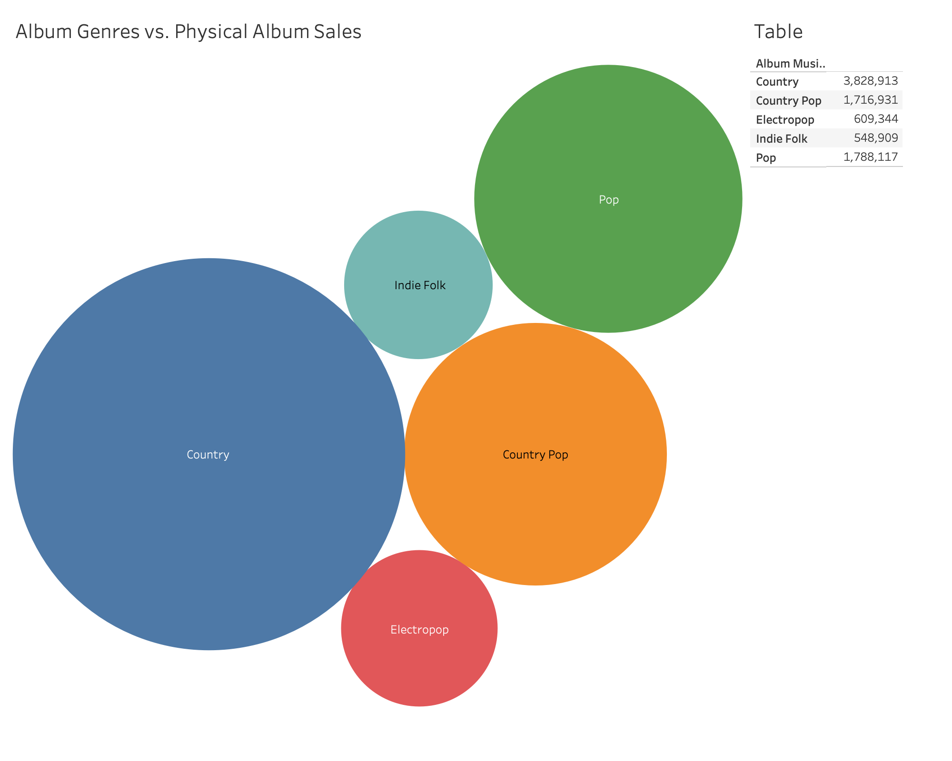
Albums categorized as “Country” had the highest number of physical album sales on average, while those categorized as “Indie Folk” and “Electric Pop” had the lowest, despite "Country Pop" track making up the majority of her discography.
Ben
Notes:
Albums categorized as “Pop” had the highest number of physical album sales on average, while those categorized as “Indie Folk” and “Electric Pop” had the lowest

Slide 12
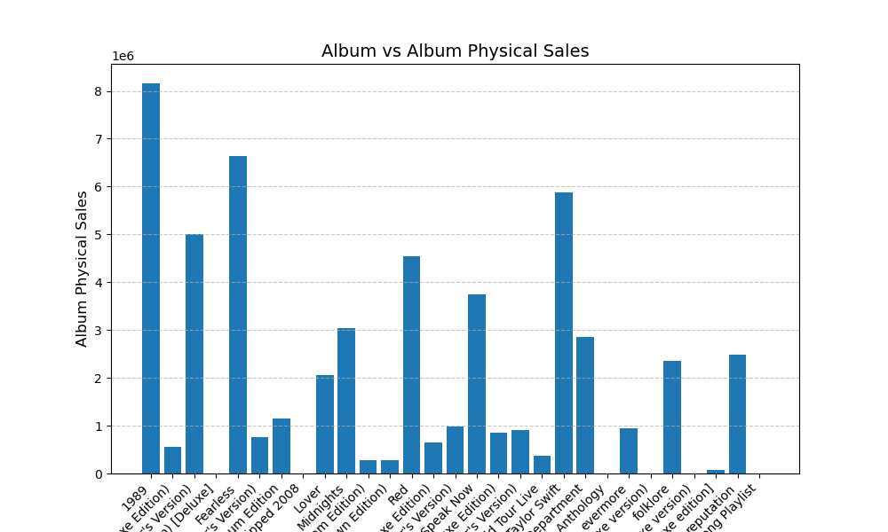
Ben

Slide 13

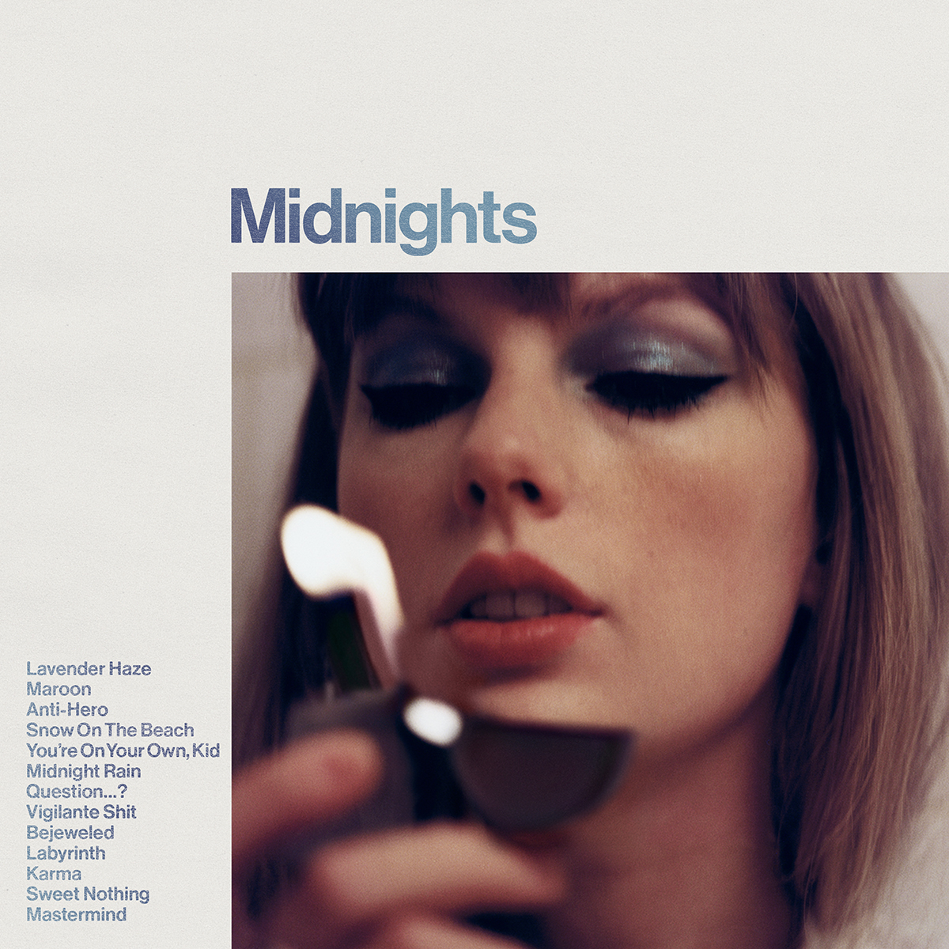
Conclusion
These findings suggest that both musical attributes and perceived emotion play a role in shaping a track’s popularity and commercial impact within Taylor Swift’s body of work.
Taylor Swift is a statistically interesting artist whose discography covers a number of genres and whose career spans multiple decades. She is also an artist who has seen vast changes in technology responsible for significant shifts in consumers’ tastes and access to music.
Ben

Slide 14


Thank You!

